Slide 1
HCI Design Patterns and
Standards
You have ethical and legal responsibilities!

Slide 2
Agenda
Patterns
  Predefined guides as to how to do things
Standards
  Rules about how to do things

Slide 3
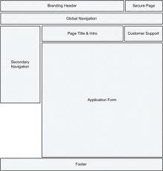
Design Patterns
First proposed by Christopher Alexander for architecture.
Adopted by other disciplines as ways to describe common problems and solutions
Software patterns
HCI patterns

Slide 4
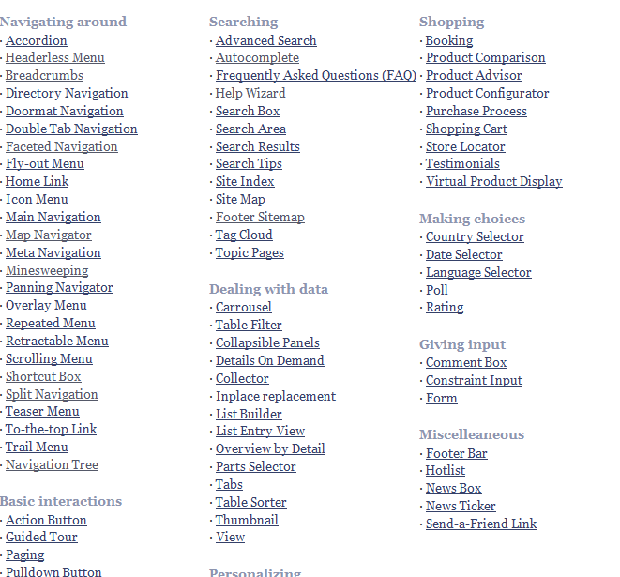
Libraries of patterns
http://www.welie.com/patterns/index.php

Slide 5
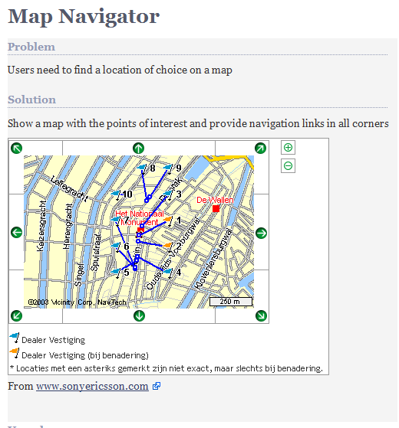
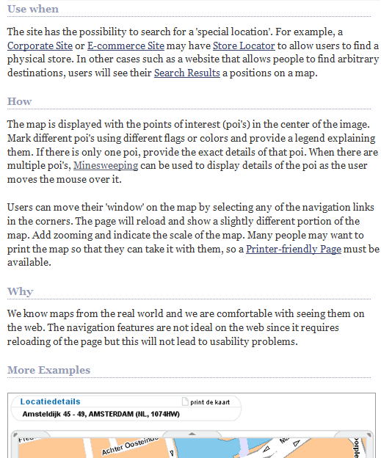
Each pattern
http://www.welie.com/patterns/showPattern.php?patternID=map-navigator

Slide 6
Patterns
Provide a solution or solutions
  May or may not be tested
Give you design ideas
Defining patterns for a large system or website will lead to
  Consistency
  Therefore better usability

Slide 7

Standards
Standards bodies
  W3C world wide web consortium
  ISO standards
  Governments
    UK
    USA
    New Zealand
  Operating Systems

Slide 8
W3C
http://www.w3.org/standards/
Free!
Technical
Comprehensive
Detailed
Well respected

Slide 9
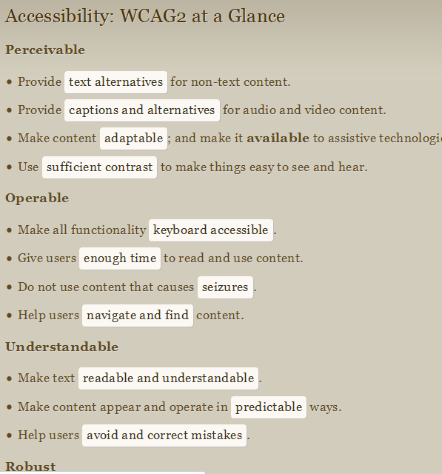
W3C example
Accessibility
http://www.w3.org/2009/cheatsheet/#wcag2

Slide 10
ISO
Not free
ISO/TR 16982:2002 Ergonomics of human-system interaction—Usability methods supporting human-centered design
  High level, for UX designer, systems analysts etc
ISO 9241 Ergonomics of Human System Interaction.
  Includes detailed recommendations from hardware to people

Slide 11
Government
Mostly concerned with accessibility
  Disability Discrimination Act UK
  Section 508 of the Rehabilitation Act (USA)
  http://webstandards.govt.nz/

Slide 12
Government
Legislation together with pressure groups have had some remarkable successes
Windows 7 has ‘windows navigator’ built in
iPad/Phone/Pod have touch accessibility
  This is really impressive!

Slide 13
Operating Systems
Microsoft
  http://msdn.microsoft.com/en-us/library/aa511258.aspx
Apple
  http://developer.apple.com/library/mac/#documentation/UserExperience/Conceptual/AppleHIGuidelines/XHIGHIDesign/XHIGHIDesign.html%23//apple_ref/doc/uid/TP30000353-TP6
Android
  http://developer.android.com/guide/practices/ui_guidelines/index.html

Slide 14
Advantages
Using patterns and guidelines
  Not reinventing the wheel
  Future-proof your designs
  Makes entry to markets easier

